Slide 1



TIPS
AT HAMPTON UNIVERSITY
Student Version

Slide 2



Why TIPS?
WHY TIPS?
To allow students, faculty, and staff as well as community members to confidentially or anonymously report accidents, concerning behaviors, suspicious activities, and numerous other types of incidents.
“TIPS expands the methods by which any member of the college community can share matters they feel need to be elevated or addressed. It is not the college’s intent to replace direct contact with college officials, but instead provide an avenue for reporting campus incidents that you feel need to be shared.”

Slide 3
WHY TIPS?
To ensure the appropriate campus personnel and threat assessment team members are immediately notified so they can coordinate appropriate intervention and response steps, as well as securely share information during investigation and ongoing monitoring efforts.
The Hampton University Police Department (HUPD) is dedicated to ensuring that your educational and/or occupational needs are met in a safe and secure environment. Students, faculty and staff who attend and/or are employed at Hampton University enter an atmosphere that is carefully planned to meet their safety and security needs.

Slide 4
WHY TIPS?
To provide a central, secure database for collecting all incident reports, maintaining threat assessment records and documenting all intervention actions taken. Central, secure platform accessed only by those with authorization and helps prevent liabilities by taking advantage of FERPA and ANSI standards.
The violence prevention and intervention program should include a system of centralized record keeping, making sure that all reports made under workplace violence prevention policy are recorded and tracked. - ANSI/SHRM WVPI.1-2011

Slide 5
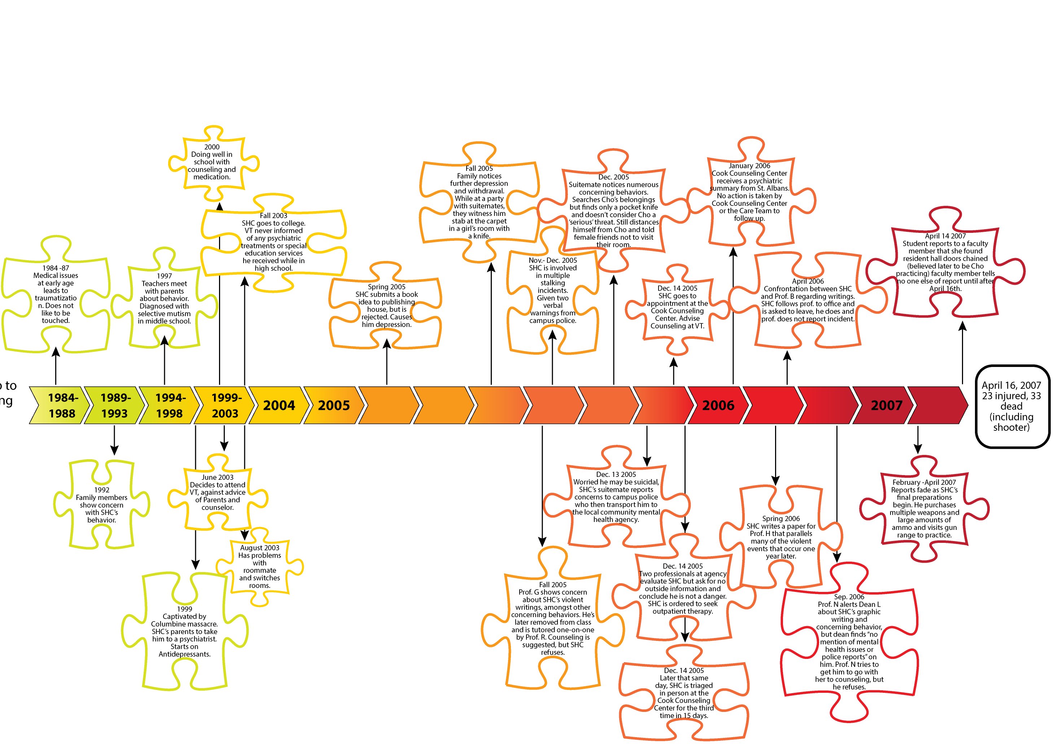
INDICATORS LEADING UP TO THE VIRGINIA TECH TRAGEDY ON APRIL 16, 2007.

Slide 6
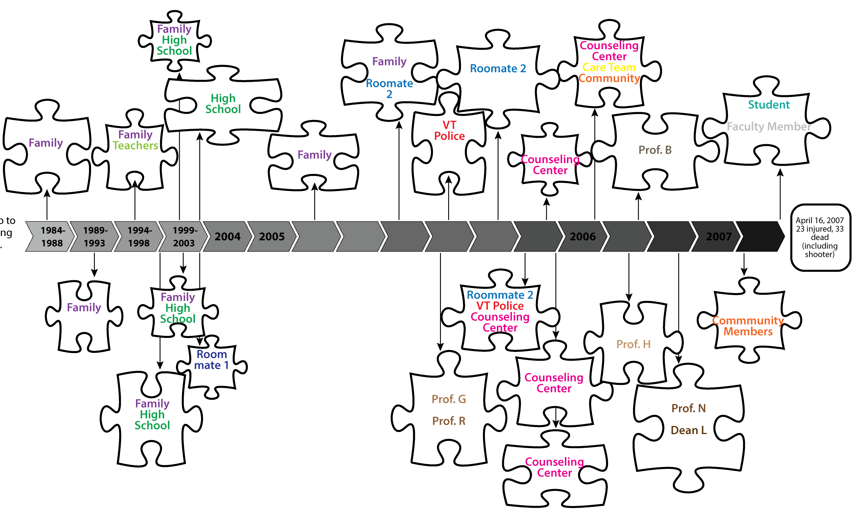
INFORMATION SILOS LEADING UP TO THE VIRGINIA TECH TRAGEDY ON APRIL 16, 2007.

Slide 7
IF WE CAN GATHER THE PIECES AFTER A TRAGEDY, WHY CAN’T WE GATHER THEM BEFORE?

Slide 8
WE CAN!
BUT WE NEED YOUR HELP!

Slide 9

Students can be the most important part of safety, threat assessment, and prevention as they hear and see things throughout the day in class and in interacting with other students that faculty, staff, and administration may not notice.
Notes:
Students can be the most important part of safety, threat assessment and prevention as they hear and see things throughout the day in class and in interacting with other students that faculty, staff and administration may not see or hear. As a student, reporting information you have can be a valuable piece of a puzzle in monitoring an at-risk individual.

Slide 10

As a student, reporting information you have can be a valuable “piece of the puzzle” in getting an at-risk individual the help they need and preventing escalations and tragedies.
Notes:
Students can be the most important part of safety, threat assessment and prevention as they hear and see things throughout the day in class and in interacting with other students that faculty, staff and administration may not see or hear. As a student, reporting information you have can be a valuable piece of a puzzle in monitoring an at-risk individual.

Slide 11
INDICATORS WE NEED TO KNOW ABOUT
Unusual or abrupt changes in behaviors, mood, personal hygiene or appearance
Extreme reaction to a loss or traumatic event
Preoccupation with weapons, violent events, or persons who have engaged in violent acts
Uncharacteristically poor performance at school or job
Notes:
Share these with students to help make them aware what the warning signs, or red flags, are for an individual who may be at-risk or may need help. It also good to point out that showing just one of these signs may not be a cause for concern, but that is why reporting them to a central secure platform like TIPS helps staff and administration connect other reports that may come in for the same individual, so they can determine if a threat is apparent.

Slide 12
INDICATORS WE NEED TO KNOW ABOUT
References to harming others or planning a violent or destructive event
Evidence of depression, hopelessness, or suicidal thoughts/plans
Inappropriate responses such as prolonged irritability, angry outbursts, or intense reactions
General statements of distorted, bizarre thoughts
Notes:
Share these with students to help make them aware what the warning signs, or red flags, are for an individual who may be at-risk or may need help. It also good to point out that showing just one of these signs may not be a cause for concern, but that is why reporting them to a central secure platform like TIPS helps staff and administration connect other reports that may come in for the same individual, so they can determine if a threat is apparent.

Slide 13
INDICATORS WE NEED TO KNOW ABOUT
Strained interpersonal relations, isolating behaviors, or low self-esteem
Significant change in life circumstances such as death of family member or pet, divorce, break-up etc.
Excessive feelings of isolation, rejection and/or persecution
Unusual or threatening social media posts
Notes:
Share these with students to help make them aware what the warning signs, or red flags, are for an individual who may be at-risk or may need help. It also good to point out that showing just one of these signs may not be a cause for concern, but that is why reporting them to a central secure platform like TIPS helps staff and administration connect other reports that may come in for the same individual, so they can determine if a threat is apparent.

Slide 14
STILL UNSURE WHAT TO REPORT?
A good rule to follow is:
“If a situation makes you or someone else uncomfortable, you should click on the TIPS button and report it.”
Notes:
Good point to ask if there are any questions on what should be reported, and discuss why its important to report any concerns.
Also a good point to define “Indicators” further as concerning behaviors, suspicious activities, social media comments, social media pictures, social media threats and other actions that make you uncomfortable.

Slide 15
WHAT ELSE SHOULD YOU REPORT IN TIPS?
Academic Dishonesty & Cheating
Acts of Kindness
Bias/Intolerance
Bullying
Campus Safety Survey
Campus Safety/Security Concern
Computer Usage Violation
Concerning Behavior
Danger to Self
Discrimination
Disruptive Behavior/Disorderly Conduct
Distressed Student
Domestic Violence
Drug Possession/Solicitation
Ethical
Fraud
Harassment
Hazing
Lost and Found
Sexual Assault
Social Media Concern
Stalking
Student Conduct Referral
Suicide Attempt or Threat
Suspicious Activity
Theft/Robbery
Threat to Harm
Unsafe Campus Conditions
Vandalism/Graffiti
Vehicle Accident/Incident
Verbal Abuse
Violation of Privacy
Weapons
Workplace Violence
Other

Slide 16
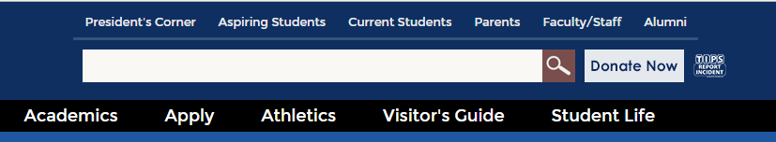
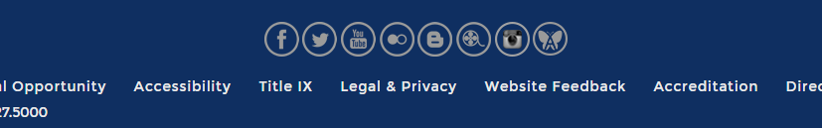
WHERE TO GO…
WWW.HAMPTONU.EDU
AT THE TOP OF OUR WEBSITE
OR AT THE BOTTOM

Slide 17
Frequently Asked Questions

Slide 18
IS MY REPORT REALLY ANONYMOUS?
YES! Utilizing the TIPS incident reporting button allows you to choose the truly anonymous option, so you have nothing to fear in sharing your observations and concerns.
Please Note: If you choose to be anonymous, Hampton University will not be able to follow-up with you, so if you want a direct response you can choose the confidential option and provide your name and/or a way to contact you by either phone or e-mail.

Slide 19
ONCE I SUBMIT A REPORT INTO TIPS, WHAT HAPPENS?
All reports are securely transmitted to and stored within Hampton University’s TIPS platform. Immediate notifications are sent to the appropriate personnel at Hampton University. Reports will only be viewed and accessible by approved personnel and all information will remain confidential. Once the team has reviewed your report/concerns, appropriate investigation and follow-up efforts will occur.

Slide 20
HOW DO I KNOW IF SOMEONE HAS TAKEN ACTION ON MY REPORT?
If you would like feedback regarding the report you submit or if you would like to be available for follow up questions, you can provide your name and contact information. All information provided will be kept strictly confidential.

Slide 21
DO I HAVE TO USE TIPS TO MAKE A REPORT?
No. TIPS should not replace face-to-face communication with faculty, staff and administrators when you have concerns or questions. TIPS is for equipping students, faculty, staff, parents and community members to share information/observations when they may be uncomfortable or unavailable to share it in person. Reporting with TIPS also ensures the information you have is always documented in the right place.

Slide 22
STILL HAVE QUESTIONS?
Contact:
Mr. Michael T Steward
  Crime Prevention/Clery Compliance Officer
  Phone: 757-727-5567
  E-mail:michael.steward@hamptonu.edu
Or stop by the Campus Safety Building

